Slide 1
UCSD Embedded RTOS Assignment 7
By
Hsuankai Chang
hsuankac@umich.edu

Slide 2
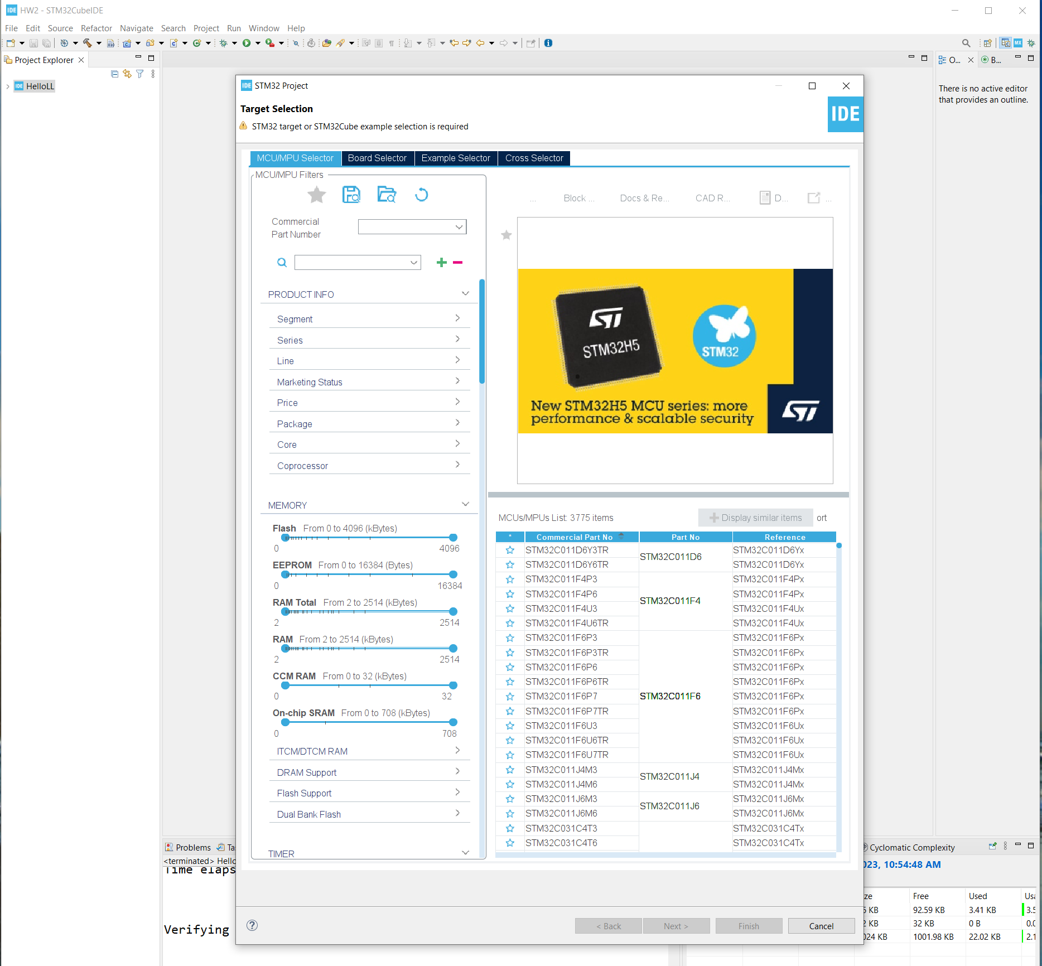
Step 1. Startup STM32CubeIDE and create new STM32 project

Slide 3
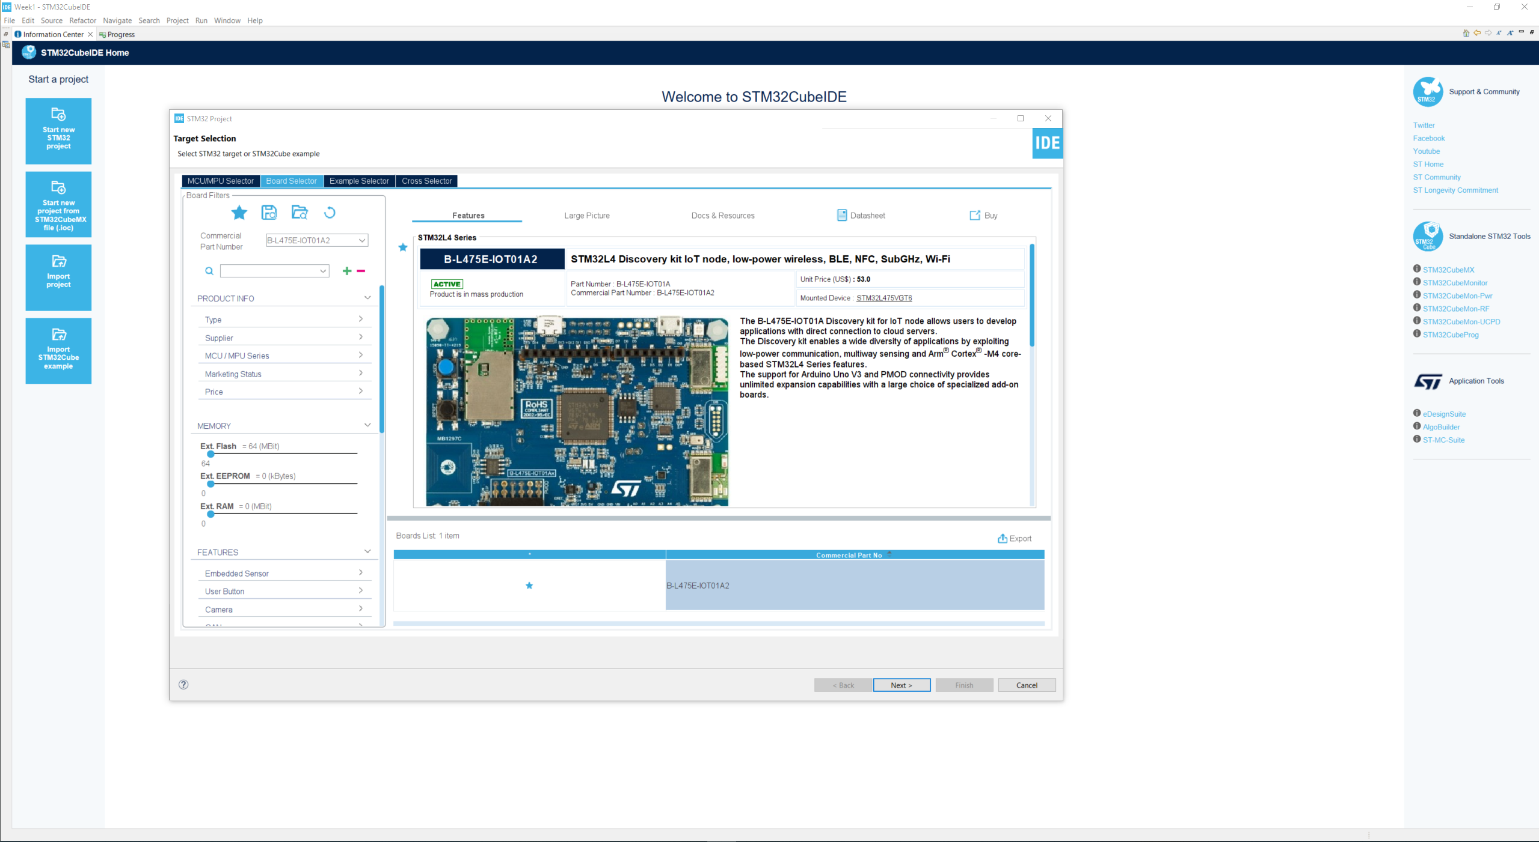
Step 2. Access board selector and type in the board you use, click Next

Slide 4
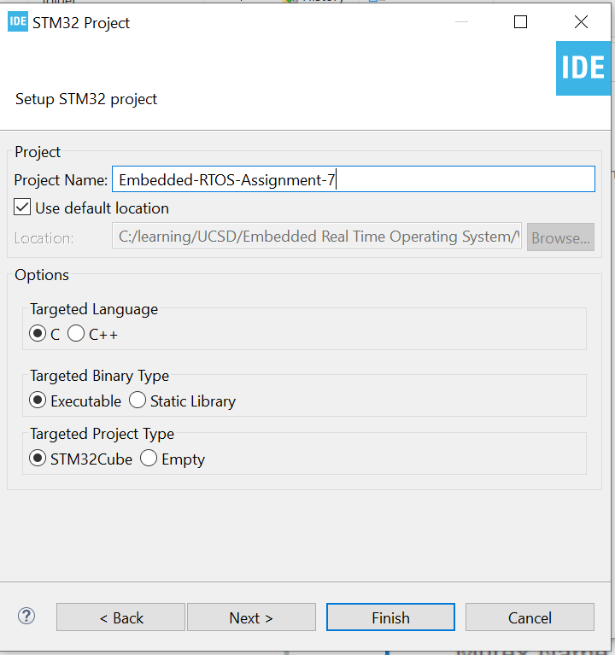
Step 3. Enter the project name then click Next

Slide 5
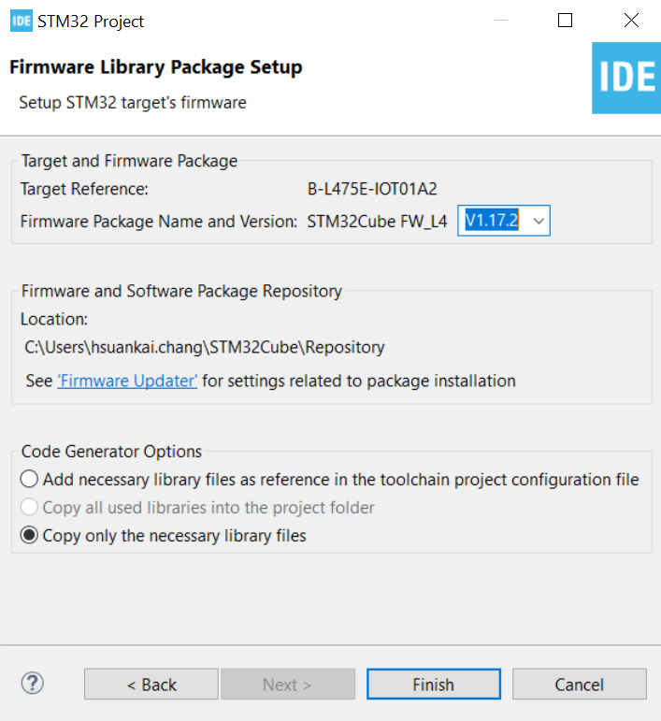
Step 4. See the firmware package name and version

Slide 6
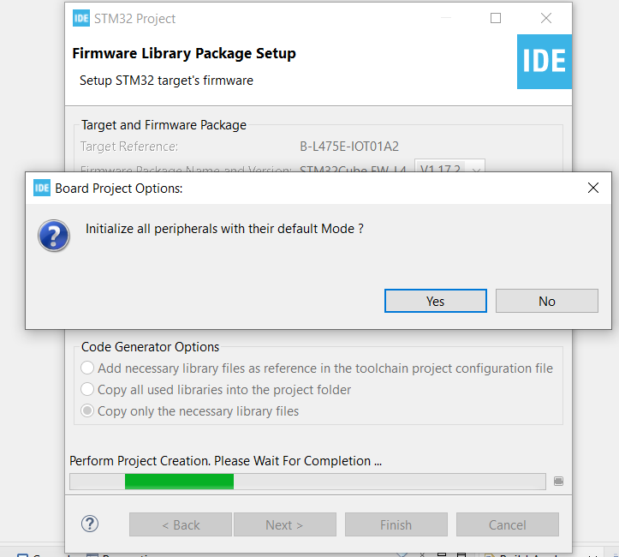
Step 5. Click yes to initialize all peripherals to default

Slide 7
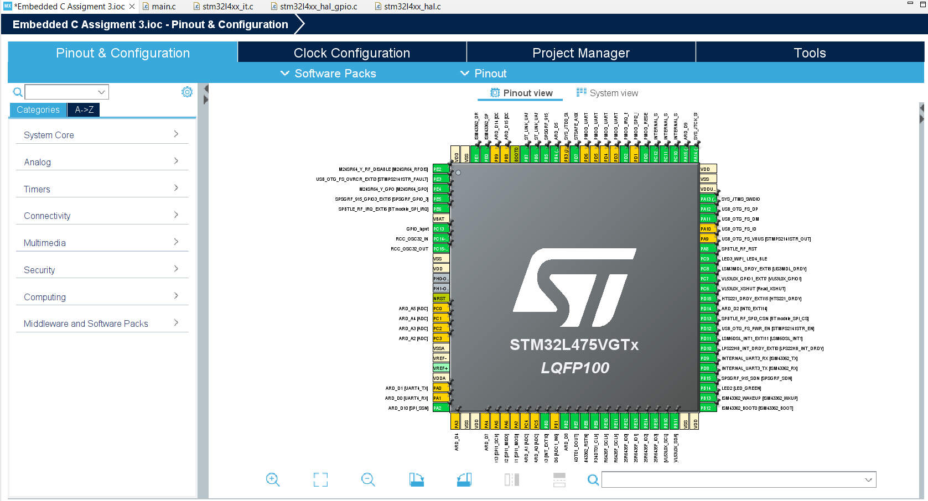
Step 6. When in .ioc file, click Pinout & Configurations

Slide 8
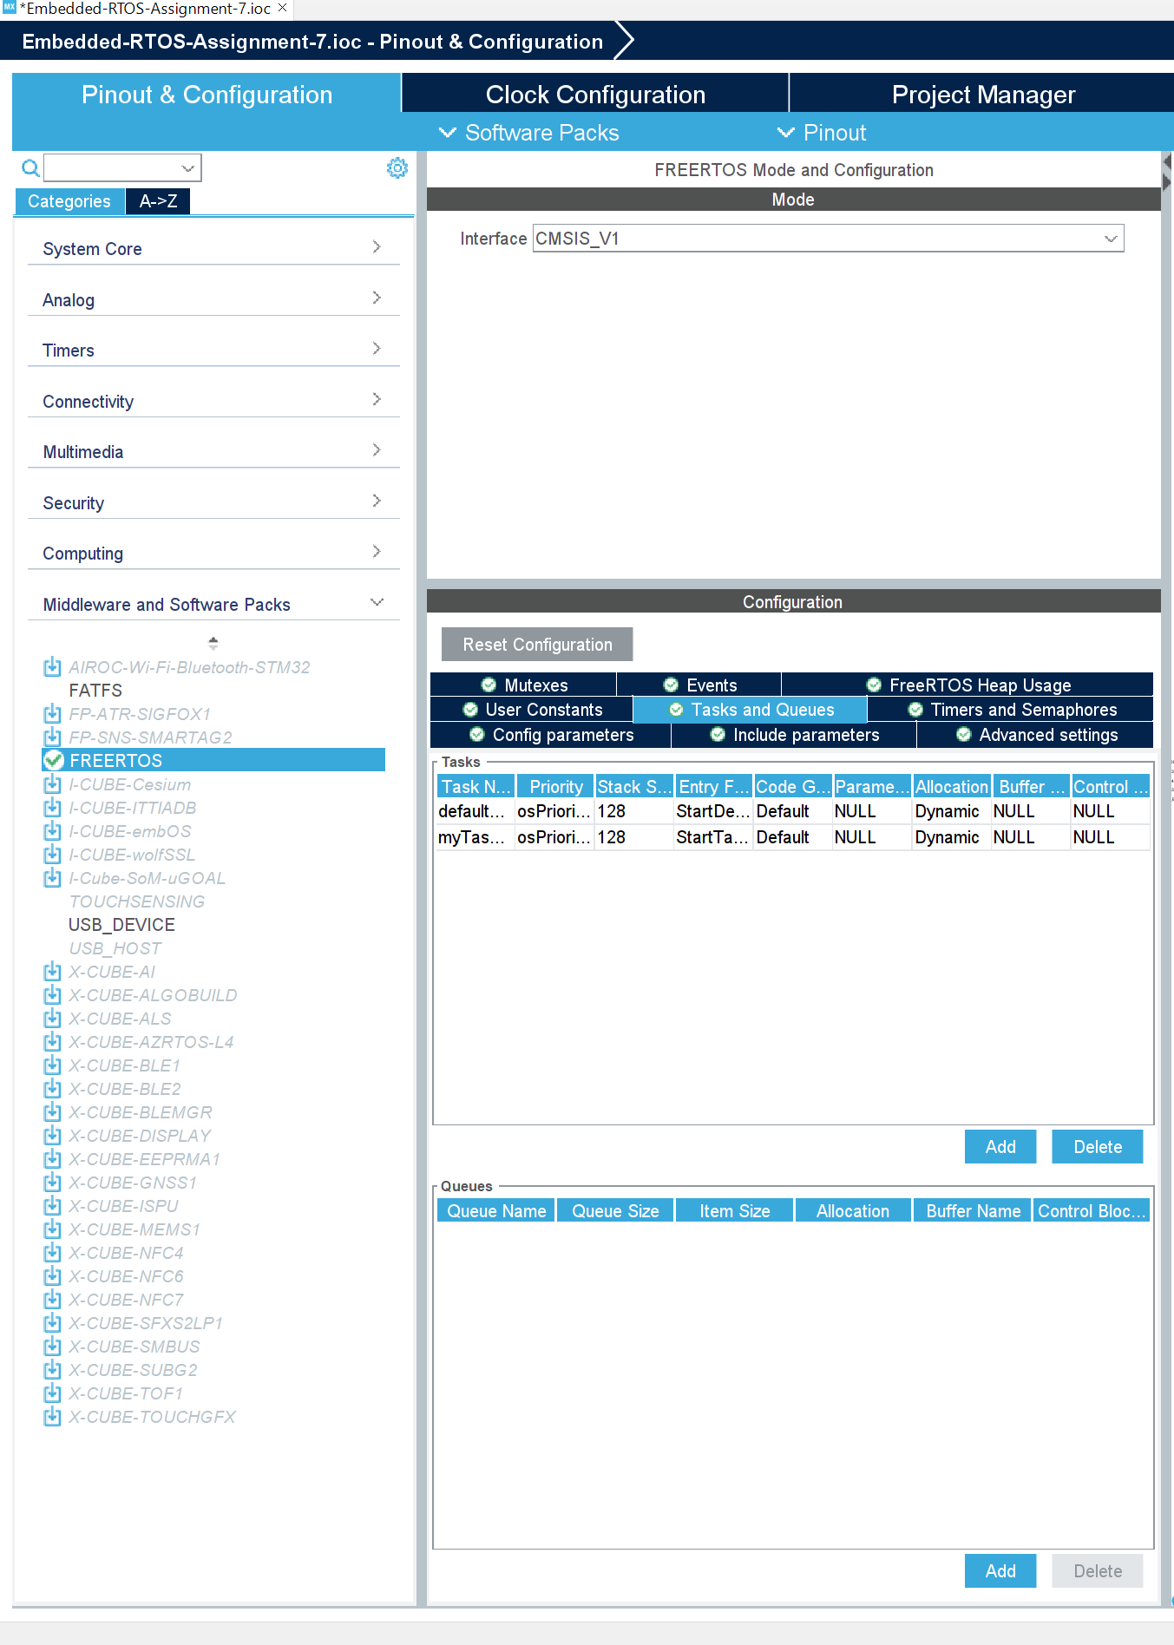
Step 7. Enable FreeRTOS CMSIS_V1 and add another task

Slide 9
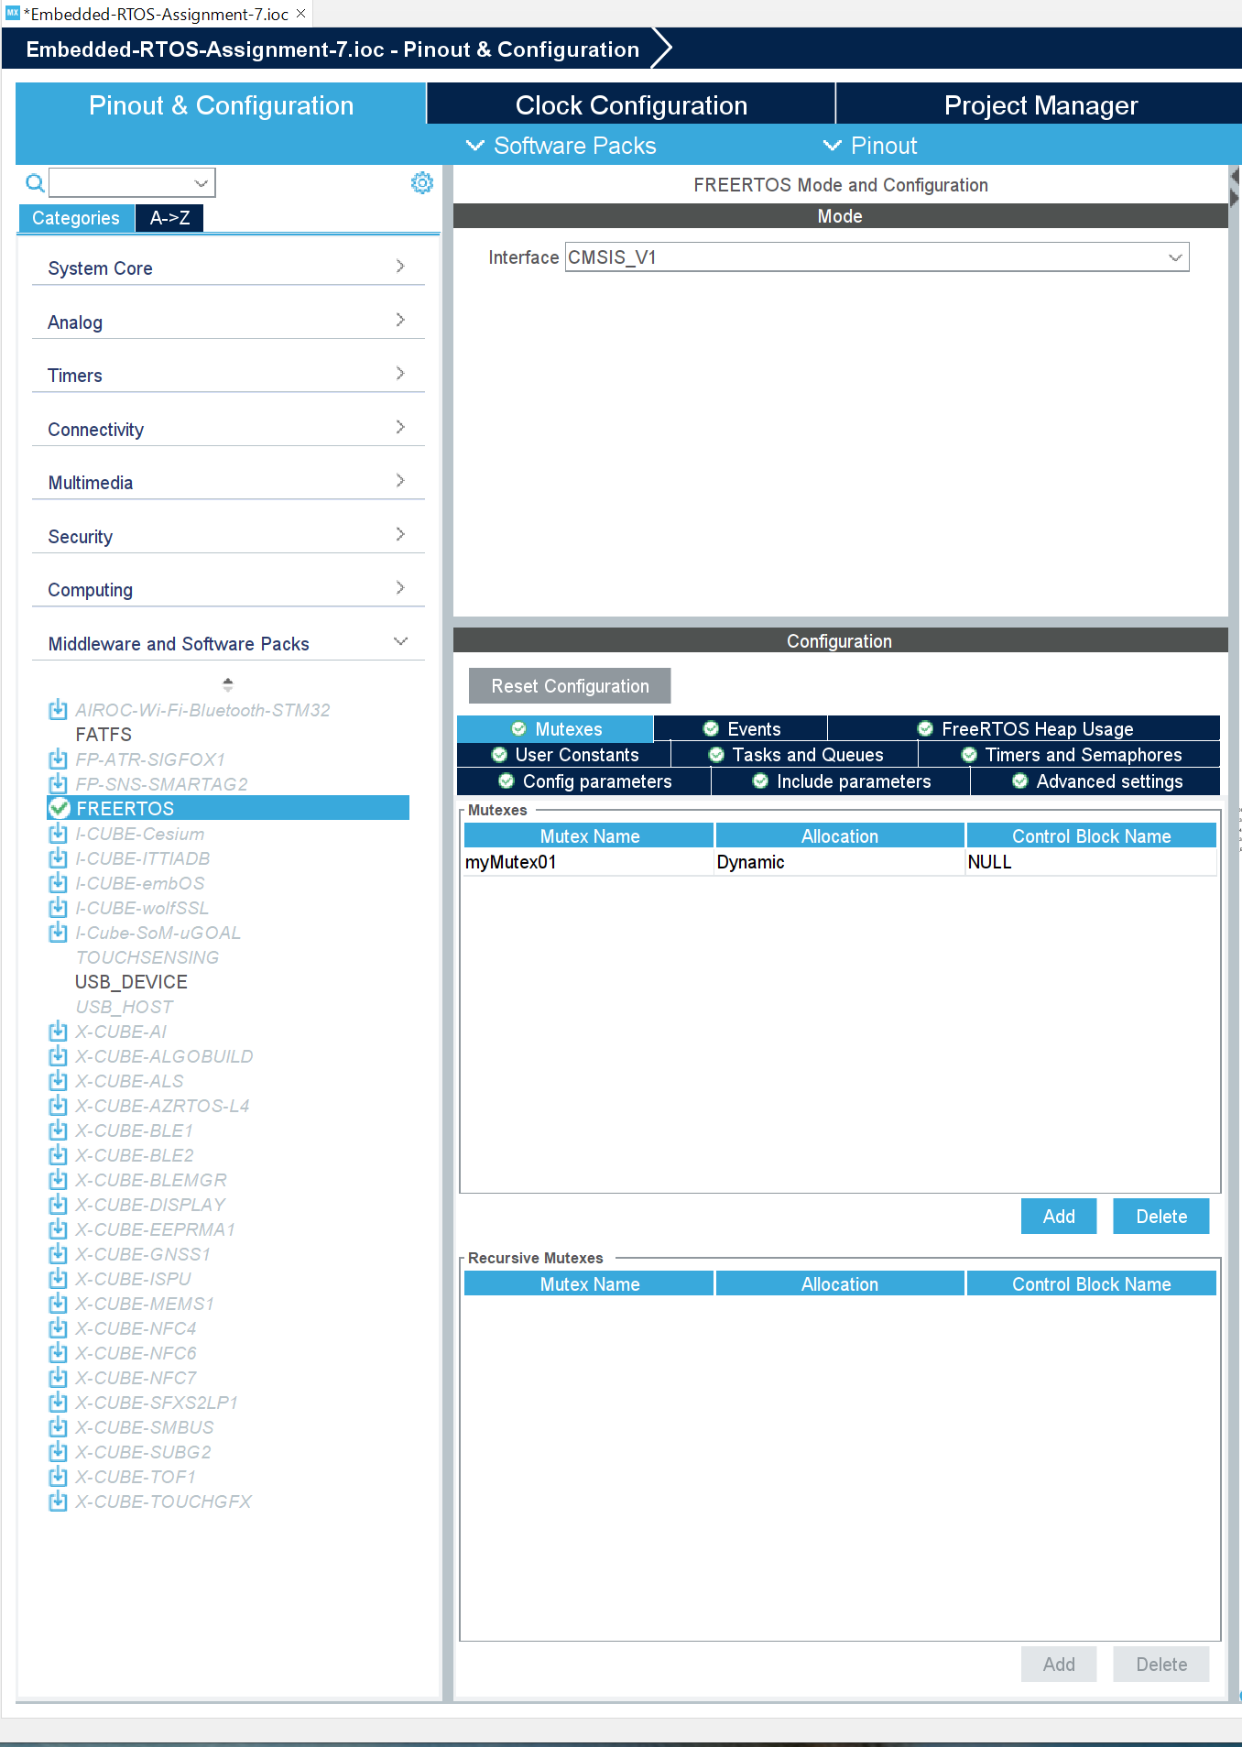
Step 8. Add mutex

Slide 10
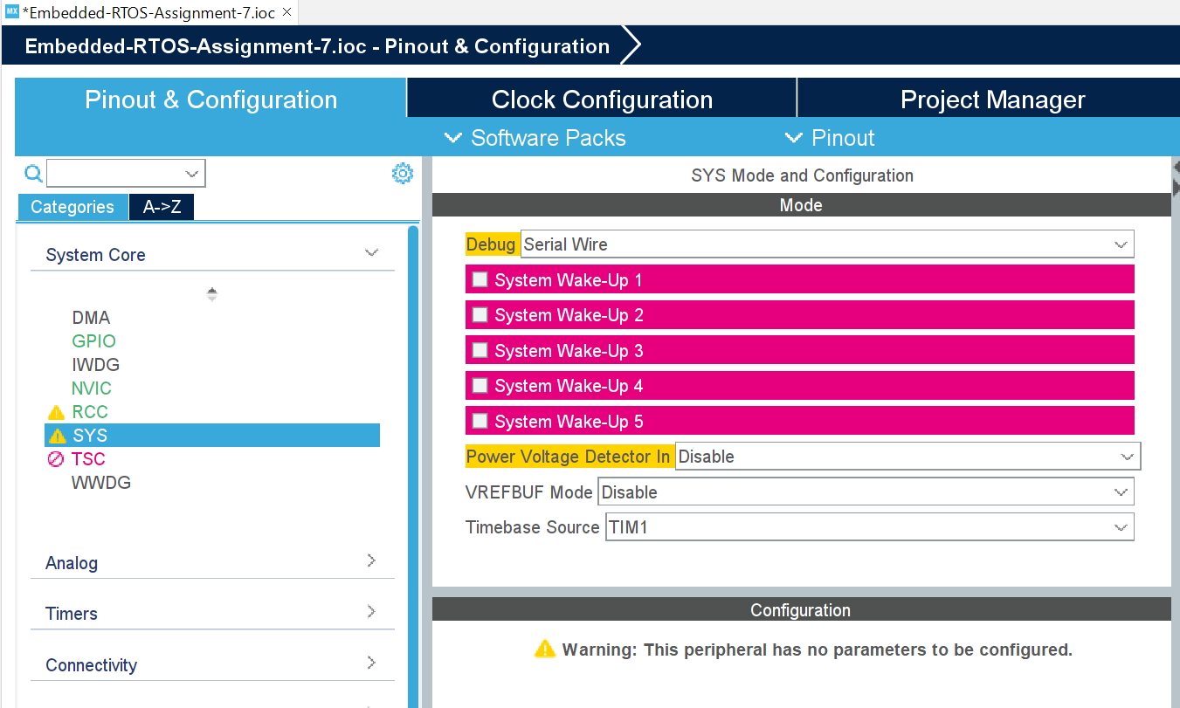
Step 9. Change time base source to TIM1

Slide 11
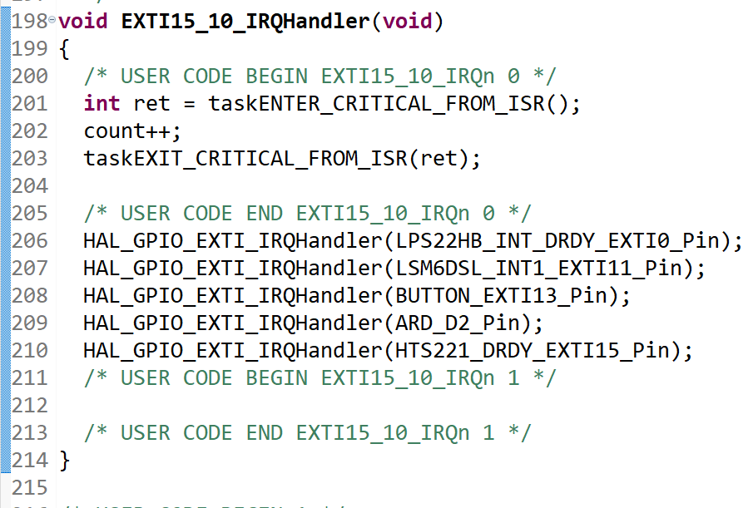
Step 10. Code the interrupt section

Slide 12
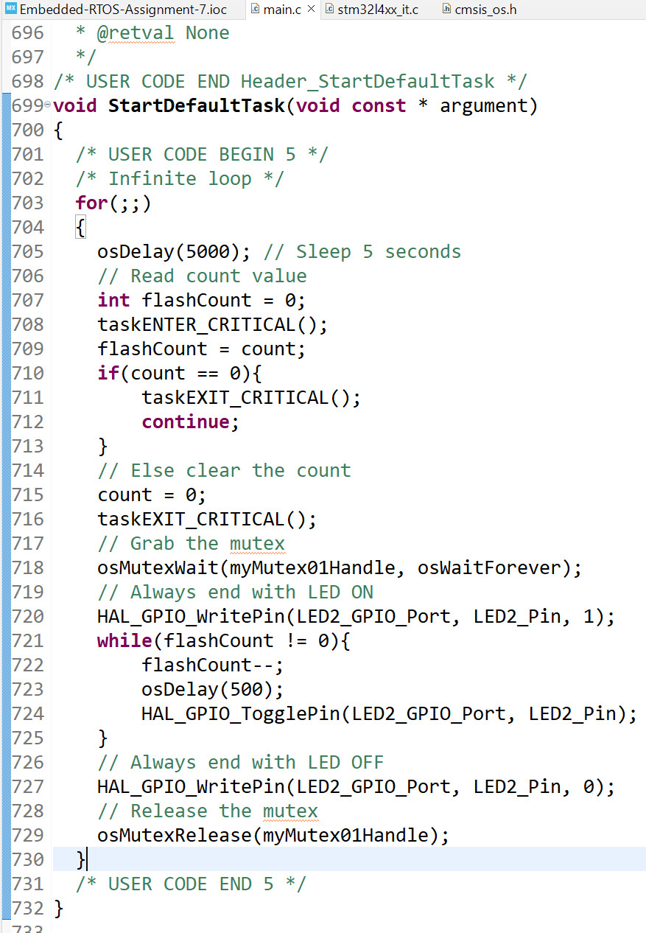
Step 11. Code the first task

Slide 13
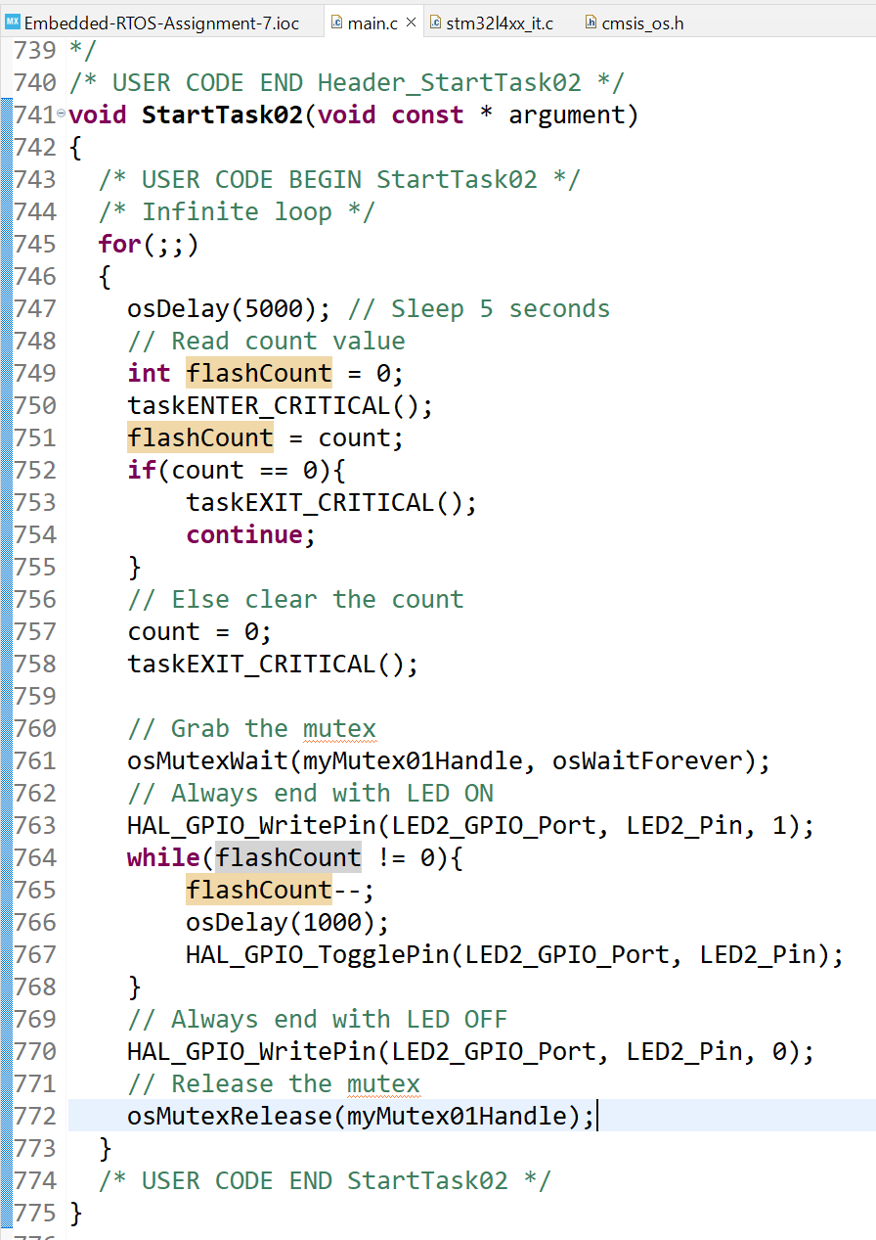
Step 12. Code the second task

Slide 14
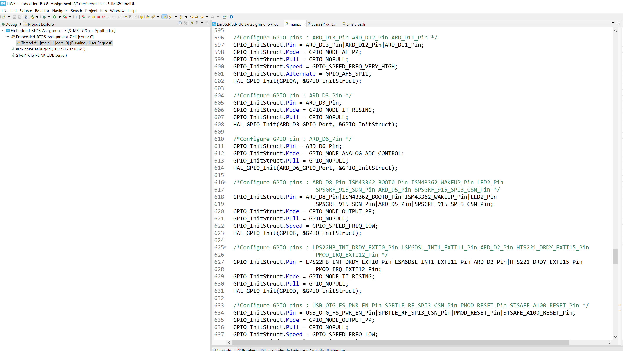
Step 13. Build and run the code, test is successful

